Slide 1

2025 NBA All Time Player List
Published by: Nate Richardson
BI Analyst/Developer
This Model uses Weighted Criteria & Bucketized Points for performance across 4 critical criteria that determine how great an NBA player was. There has been a lot of discussion in the Sports Media & on Social Media lately around the best player of all time as well as the best list of the top all-time players in league history. This list is built with a combination of fair & logical criteria across all objective statistics that determine how successful a player was in their career.
Longevity, Skill, Dominance & League Impact (even after the player retired) are among the various factors accounted for in the project. Go to this Youtube link to see my hour long video that breaks down each player’s points & placing!
LINK To Review Video https://youtu.be/ye2Z1iyIdtk

Slide 2
Summary of Criteria Winning And Accolades: NBA Championships, NBA MVP, NBA Finals MVP, Rookie of the Year, Defensive Player of the Year, Regular Season Winning Pct, Playoffs Winning Pct. Statistics: Points Per Game, Rebounds Per Game, Assists Per Game, Steals Per Game, Blocks Per Game, All-Time Stat Leaders (Top 5 All-Time) Longevity & Sustained Superior Performance: All-NBA 1st, 2nd & 3rd Team, All-Defense 1st & 2nd Team, Scoring Title, Rebounding Title, Assists Title, Steals Title, Blocks Title Legacy & Impact: Subjective Score from a Scale of 0 through 50 to guage the overall impact that the player had on the sport of basketball (both on & off the court). This can include: Cultural, Style of Play/Rules, Generational Impact etc.

Slide 3
Breakdown of Criteria: Winning & Accolades
NBA Championship – 4 points
NBA Finals MVP – 3 points
NBA MVP – 2 points
DPOY (Defensive Player of the Year) – 4 points
ROY (Rookie of the Year) – 3 points
6MOY (6th Man of the Year) – 2 points
All- Star Game Appearance - .25 points1
Career Regular Season Winning Pct. - > 60% (1.5 Points) / > 70% (3 points)
Career Playoff Winning Pct. - > 55% (1.5 Points) / > 60% (3 points)

Slide 4
Breakdown of Criteria: Statistics
Weighted Points for Points Per Game: Season Multiplier for 1 pt per point
Weighted Points for Rebounds Per Game: Season Multiplier for 1 pt per rebound
Weighted Points for Assists Per Game: Season Multiplier for 1 pt per assist
Weighted Points for Blocks Per Game: Season Multiplier for 1 .5 pt per block
Weighted Points for Steals Per Game: Season Multiplier for 1 .5 pt per steal
Total Player Score for Career “Per Game” Statistics=
SUM (weighted pts + weighted rebs + weighed ast + weighted blk + weighted stl)

Slide 5
Breakdown of Criteria: Longevity + Sustained Superior Performance
All - NBA 1st Team – 3 points
All- NBA 2nd Team – 2 points
All – NBA 3rd Team – 1 point
All - NBA Defensive 1st Team – 2 points
All – NBA Defensive 2nd Team – 1 point

Slide 6
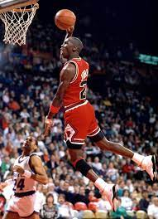
Michael Jordan #1 250.28 Total Points
Points for Career Stats: 56.28 pts
Points for Winning/Accolades & Longevity/SSP: 144 pts
Impact & Legacy: 50/50
Jordan has 10 scoring titles, 6 NBA Championships, 3 Steals titles & 5 NBA MVPs. He is one of the greatest 2-way players as well with 9 career All-NBA First Teams. Jordan scores a 50 on his impact on the game for being the trailblazer of the player contracts for shoes/commercials. He is worth over 3.5 Billion USD in 2025.

Slide 7
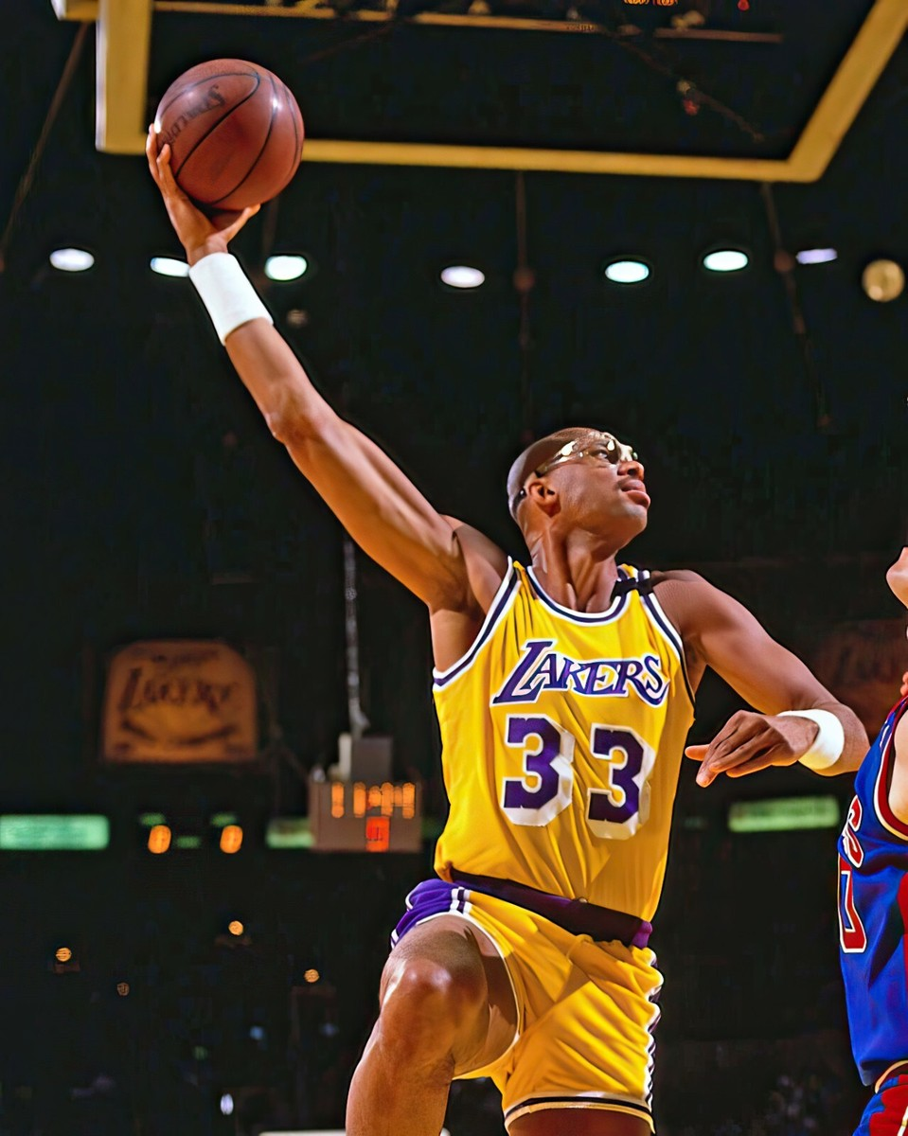
Kareem Abdul-Jabbar #2 233.04 Total Points
Points for Career Stats: 52.79 pts
Points for Winning/Accolades & Longevity/SSP: 134.25 pts
Impact & Legacy: 46/50
Kareem 2 scoring titles,1 blocks title, 6 NBA Championships, 6 NBA MVPs & won ROY in 1971. He has one of the most iconic shots in league history that was unstoppable.

Slide 8
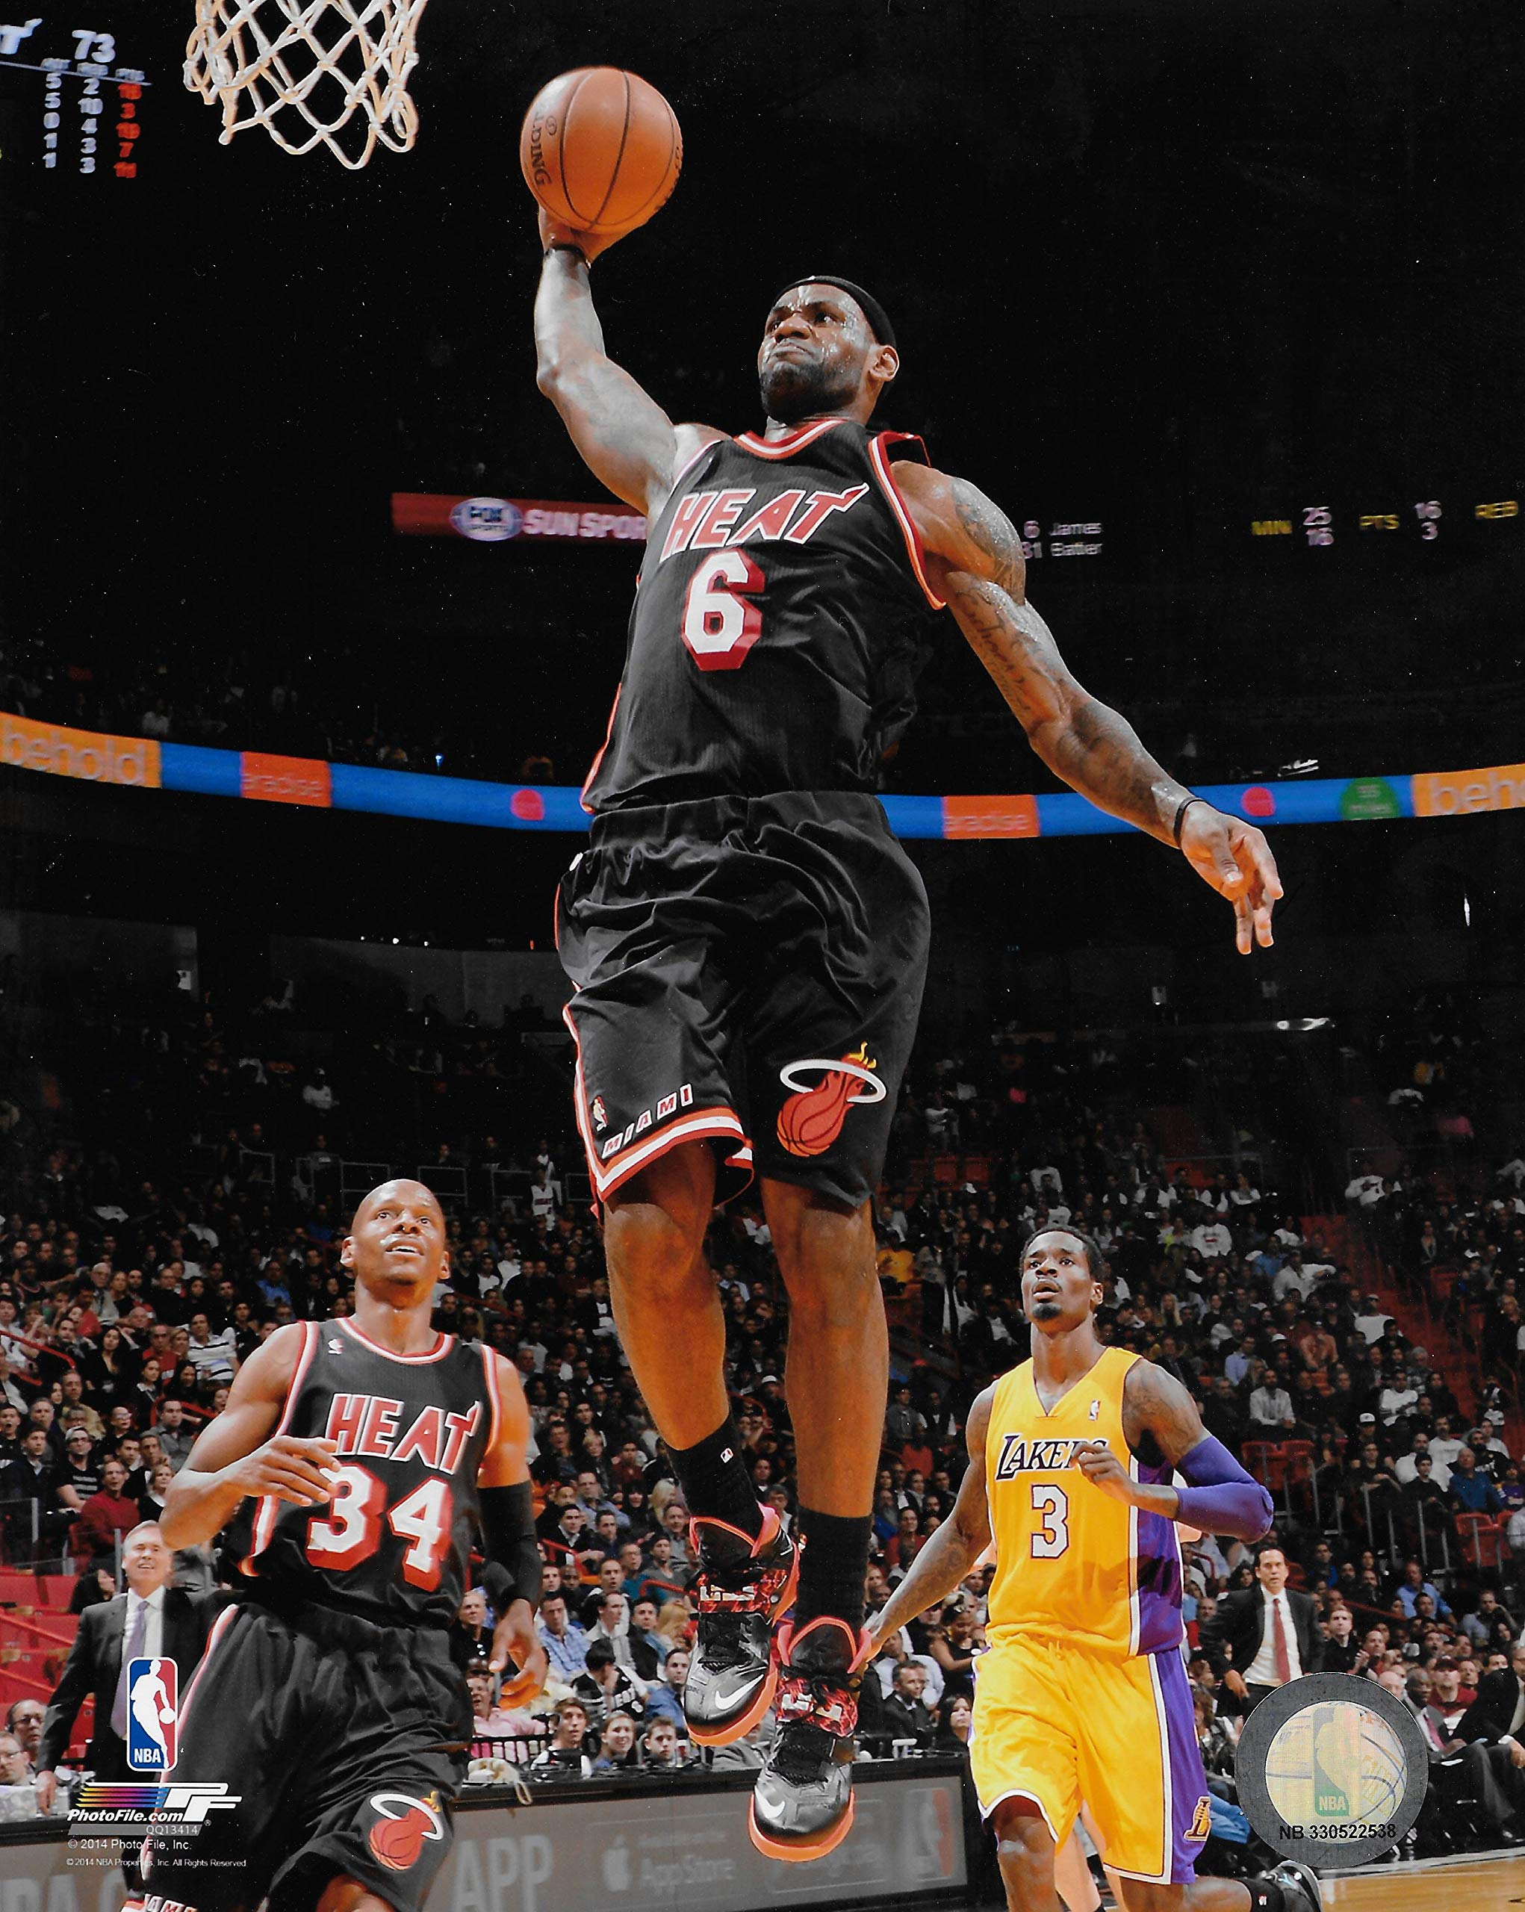
LeBron James #3 226.39 Total Points
Points for Career Stats: 57.14 pts
Points for Winning/Accolades & Longevity/SSP: 119.25 pts
Impact & Legacy: 50/50
LeBron has the most career points in history and has won 4 NBA Titles. He has also won 4 MVPs and was an all-defensive player 6 times in his 22-year career.

Slide 9
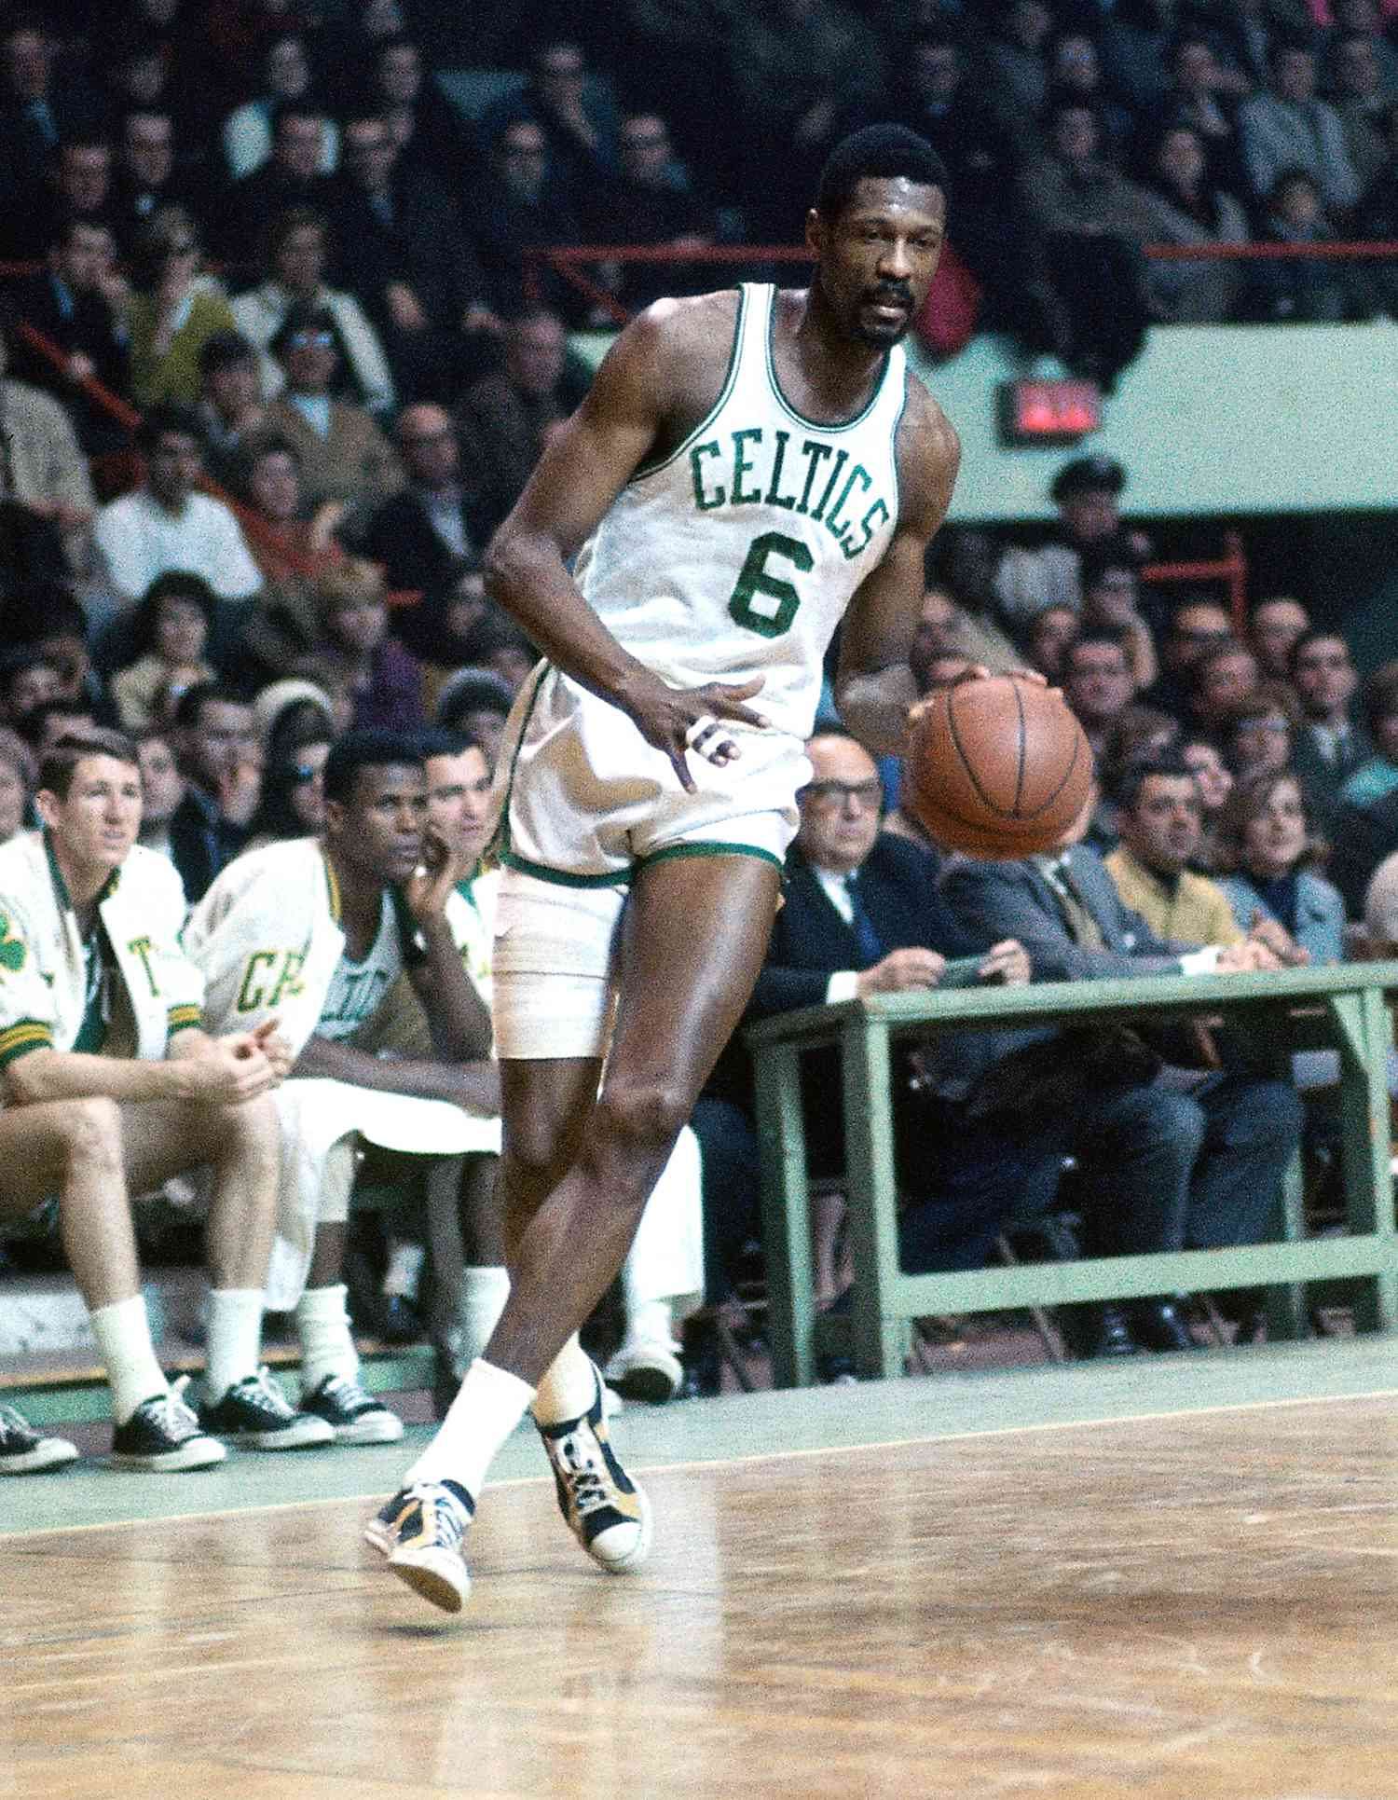
Bill Russell #4 202.35 Total Points
Points for Career Stats: 45.35 pts
Points for Winning/Accolades & Longevity/SSP: 110 pts
Impact & Legacy: 47/50
Bill Russell is considered the greatest winner in NBA History with 11 titles with the Boston Celtics. He played with 7 other hall of famers in his 13-year career and averaged an incredible 22.5 rebounds.

Slide 10
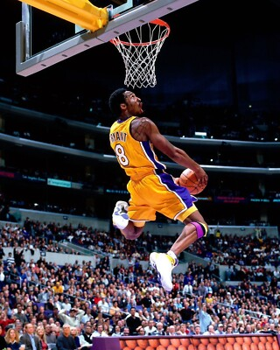
Kobe Bryant #5 200.04 Total Points
Points for Career Stats: 49.04 pts
Points for Winning/Accolades & Longevity/SSP: 101 pts
Impact & Legacy: 50/50
Kobe Bryant has been noticed as one of the hardest working superstars in league history. He has 5 NBA Championships and won the MVP in 2008. He has 33,643 career points placing him 4th all-time; Kobe is one of the most prolific scorers ever.

Slide 11
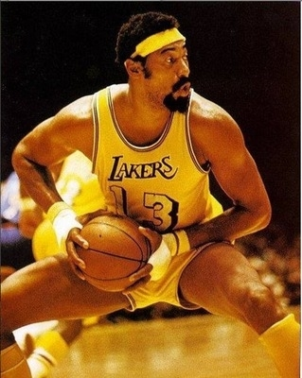
Wilt Chamberlain #6 195.28 Total Points
Points for Career Stats: 63.03 pts
Points for Winning/Accolades & Longevity/SSP: 90.25 pts
Impact & Legacy: 42/50
Wilt Chamberlain has the most impressive ‘per-game’ stat profile in history; averaging 30 PPG & 22.9 RPG. He led the league 11 times in total rebounds & is the owner of the only 100pt game in history (1962).

Slide 12
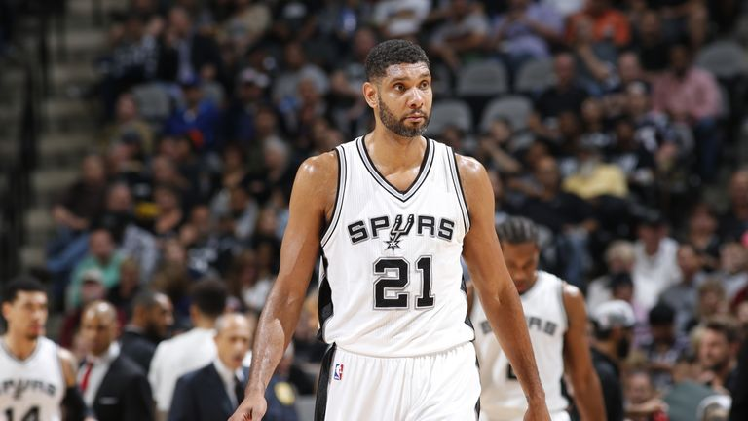
Tim Duncan #7 195.28 Total Points
Points for Career Stats: 51.07 pts
Points for Winning/Accolades & Longevity/SSP: 109.75 pts
Impact & Legacy: 32/50
Tim Duncan has the most All-NBA Accolades of all-time; with 15 All-NBA teams and 15 All-Defensive teams. He has won NBA championships in 3 different decades. Duncan is one of the 3 best 2-way players of all-time.

Slide 13
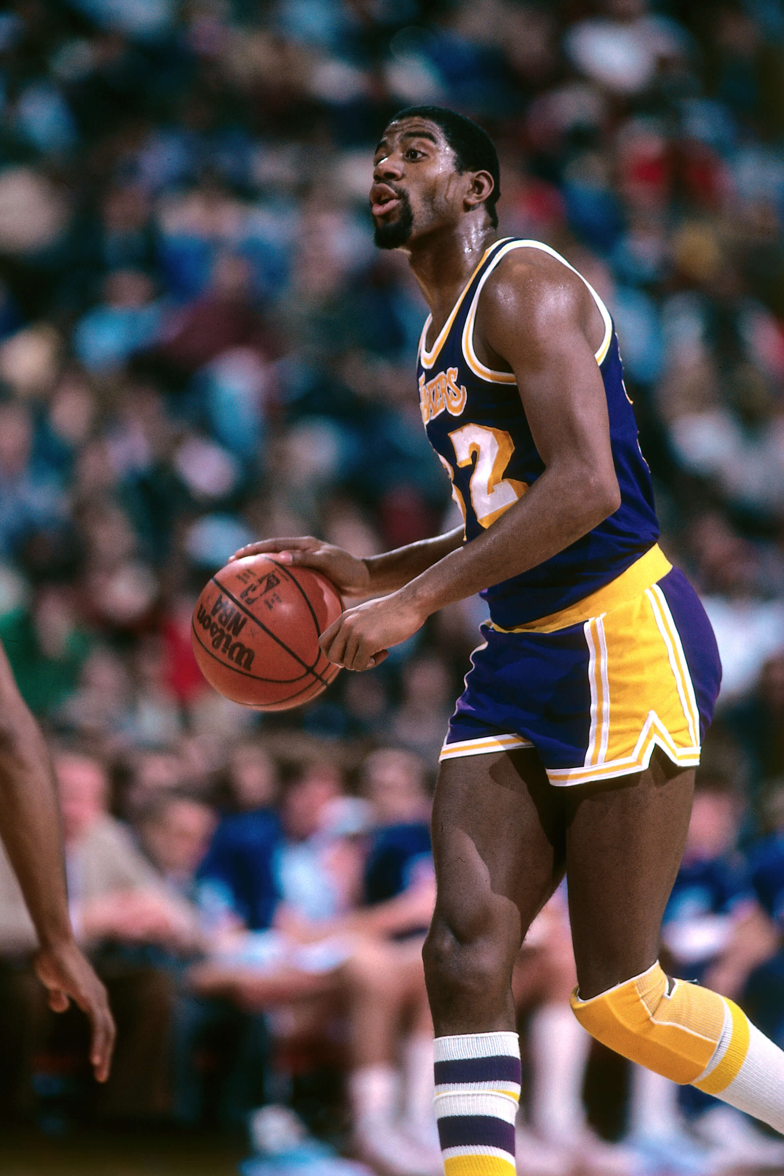
Magic Johnson #8 184.13 Total Points
Points for Career Stats: 51.07 pts
Points for Winning/Accolades & Longevity/SSP: 109.75 pts
Impact & Legacy: 32/50
Magic was the leader of the best team in the 80s: the “Showtime Lakers”. He won 5 titles during that decade and is widely considered the greatest point guard of all-time. Magic’s career was cut short but he is still a top 10 all-time great.

Slide 14
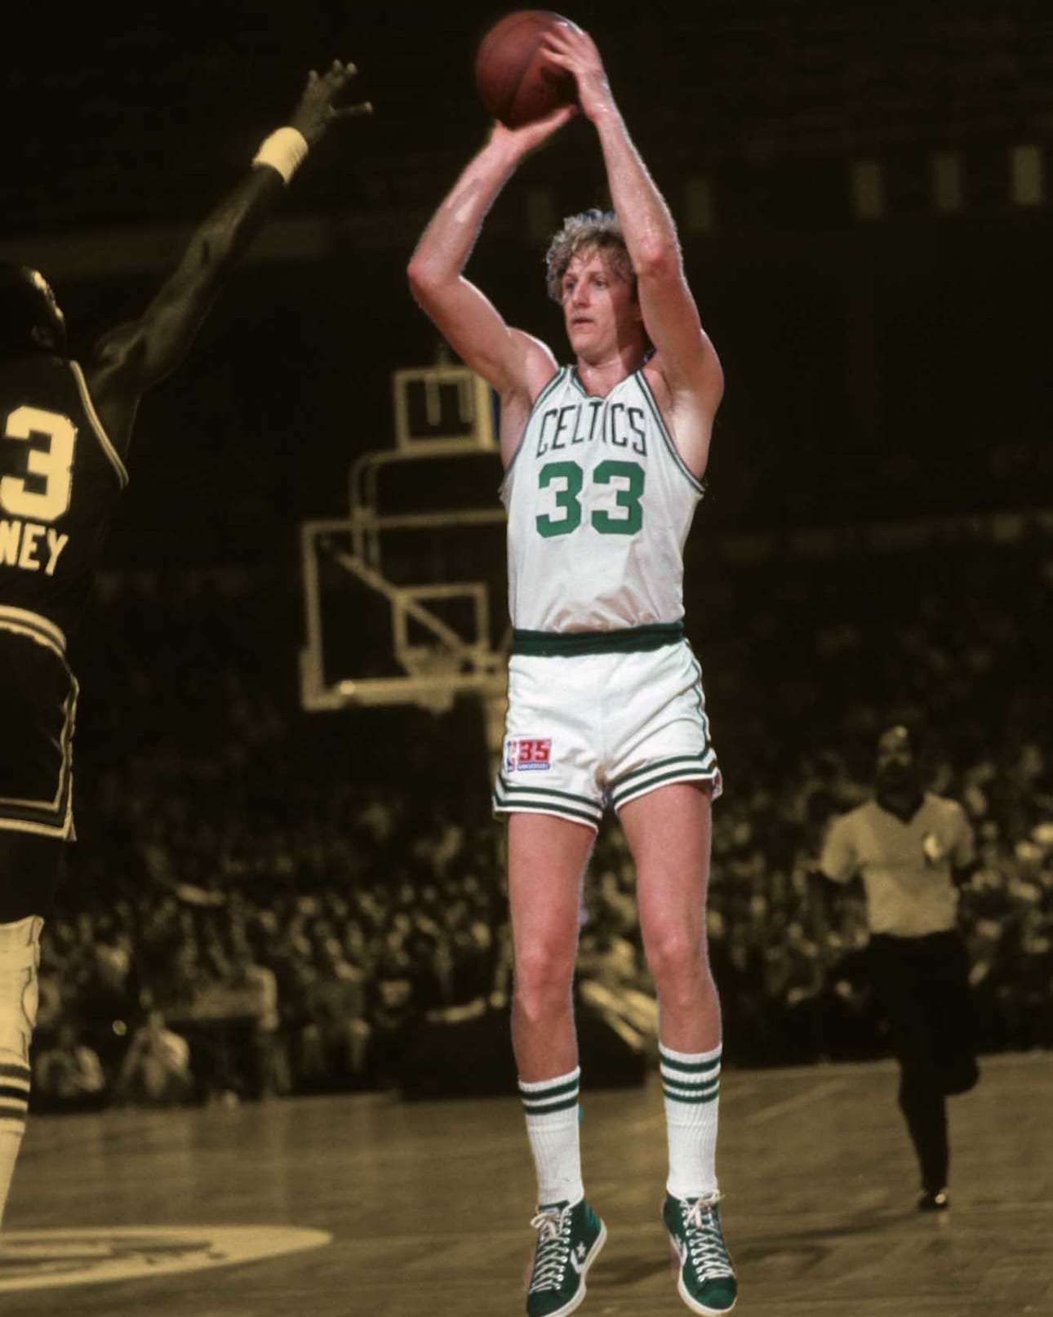
Larry Bird #9 179.22 Total Points
Points for Career Stats: 54.22 pts
Points for Winning/Accolades & Longevity/SSP: 75 pts
Impact & Legacy: 50/50
Larry Bird was a 3-time MVP who played against Magic, Jordan and the Pistons during the 80s. He is considered on of the smartest & most skilled players in NBA history. While he wasn’t the most talented, players respect his legacy as legendary winner.

Slide 15
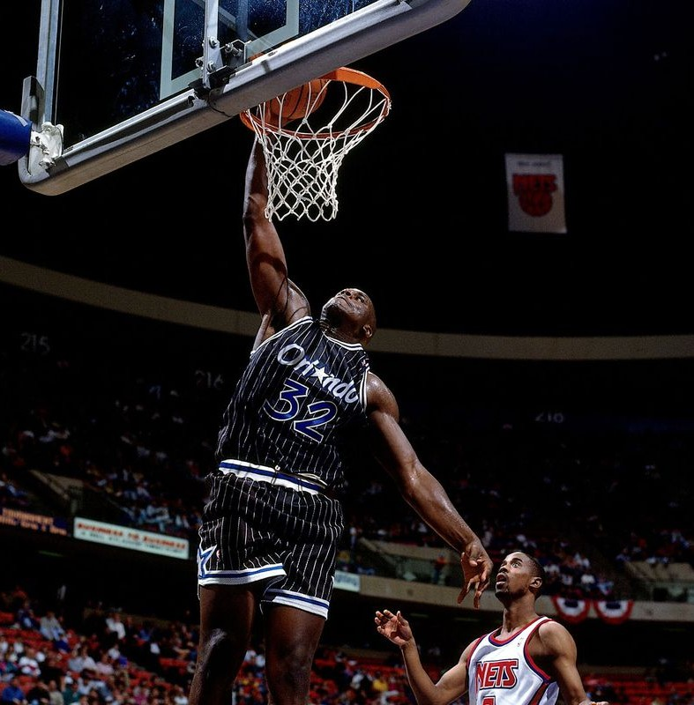
Shaquille O’Neal #10 174.43 Total Points
Points for Career Stats: 54.68 pts
Points for Winning/Accolades & Longevity/SSP: 74.75 pts
Impact & Legacy: 45/50
Shaq had a great career for 3 different teams. He played 5 seasons in Orlando and then won 3 NBA titles with the Lakers & one with the Heat in 2006. He is arguably the most dominant big man to ever play basketball.

Slide 16
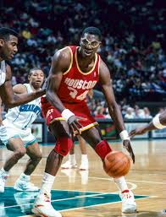
Hakeem Olajuwan #11 158.64 Total Points
Points for Career Stats: 54.64 pts
Points for Winning/Accolades & Longevity/SSP: 74 pts
Impact & Legacy: 30/50
Hakeem the Dream is regarded as “The Standard” for a classic big man in the NBA. He was a solid defender, had great post moves and averaged over 3.0 Blocks per game for his career; the all-time leader in career blocks (3,830)

Slide 17
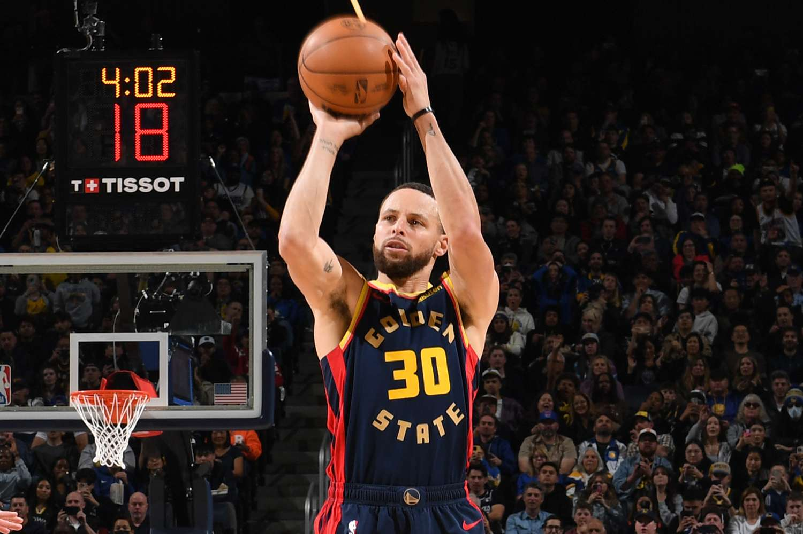
Stephen Curry #12 157.72 Total Points
Points for Career Stats: 46.47 pts
Points for Winning/Accolades & Longevity/SSP: 61.25 pts
Impact & Legacy: 50/50
Steph is on a one-name basis with the entire sports world. He is the greatest shooter God has ever created; all-time leader with 4058 3pt FG and counting! He has had plenty Olympic success as well (particularly last summer in the Gold Medal game).

Slide 18
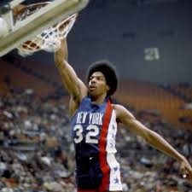
Julius Erving #13 152.18 Total Points
Points for Career Stats: 49.62 pts
Points for Winning/Accolades & Longevity/SSP: 56.5 pts
Impact & Legacy: 46/50
Julius Erving was the guy who connected the ABA with the NBA to open the door for other legends to thrive. He is known for iconic dunks and a fresh new style from the 70s. Dr J won 4 MPPs and one NBA Championship.

Slide 19
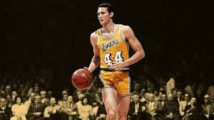
Jerry West #14 148.84 Total Points
Points for Career Stats: 42.84 pts
Points for Winning/Accolades & Longevity/SSP: 58 pts
Impact & Legacy: 48/50
Jerry West (aka The Logo) had a
Tremendous career making 10 All-NBA
1st Teams. West was a Finals MVP when he finally won the title in 1972

Slide 20
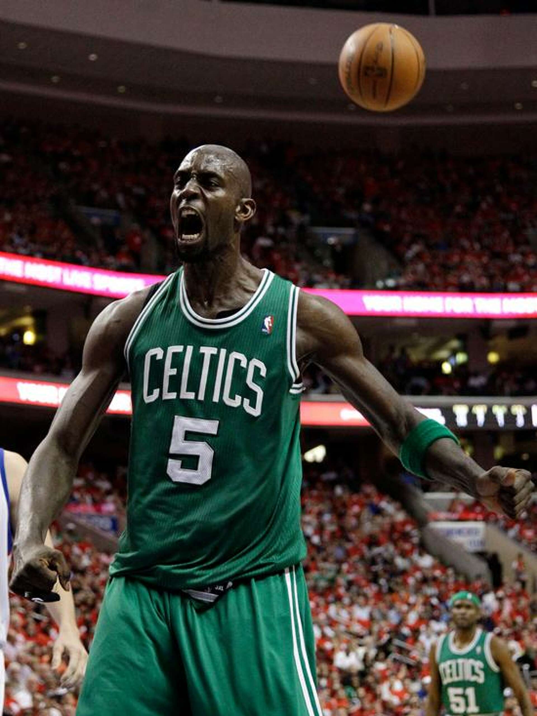
Kevin Garnett #15 147.69 Total Points
Points for Career Stats: 47.94 pts
Points for Winning/Accolades & Longevity/SSP: 61.75 pts
Impact & Legacy: 38/50
KG is one of he best 2-way power forwards of all time. He won DPOY in 2008 when the Celtics won their first title in 22 years. KG had a long and consistent career and contributes to the NBA with his commentary today.

Slide 21
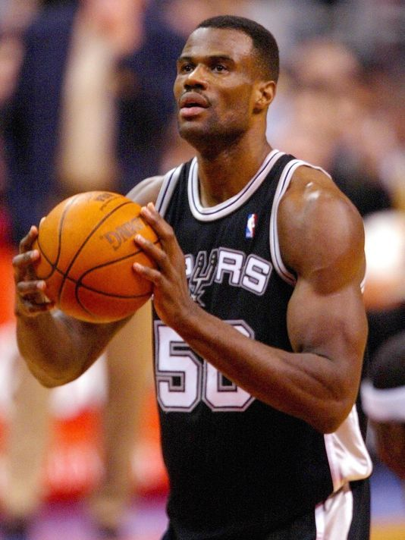
David Robinson #16 144.32 Total Points
Points for Career Stats: 53.32 pts
Points for Winning/Accolades & Longevity/SSP: 61 pts
Impact & Legacy: 30/50
David Robinson was the first overall pick in the 1987 NBA Draft. He was able to win 2 NBA Titles with Tim Duncan and is another one of the best 2-way big men of all-time. Like 2 other players in the top 20, he won an MVP and DPOY in his prime.

Slide 22
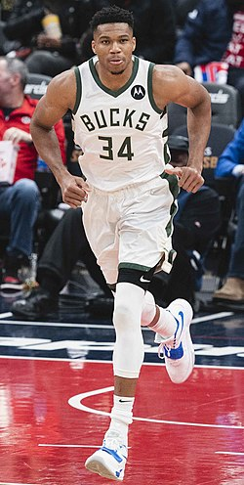
Giannis Antetokounmpo #17 147.69 Total Points
Points for Career Stats: 52.06 pts
Points for Winning/Accolades & Longevity/SSP: 56.25 pts
Impact & Legacy: 35/50
Giannis is still in his prime. He has made 7 straight All-NBA 1st teams and is considered a top 3 player in the league for several more years to come. He gets to the Free-Throw line more than any player in the game.

Slide 23
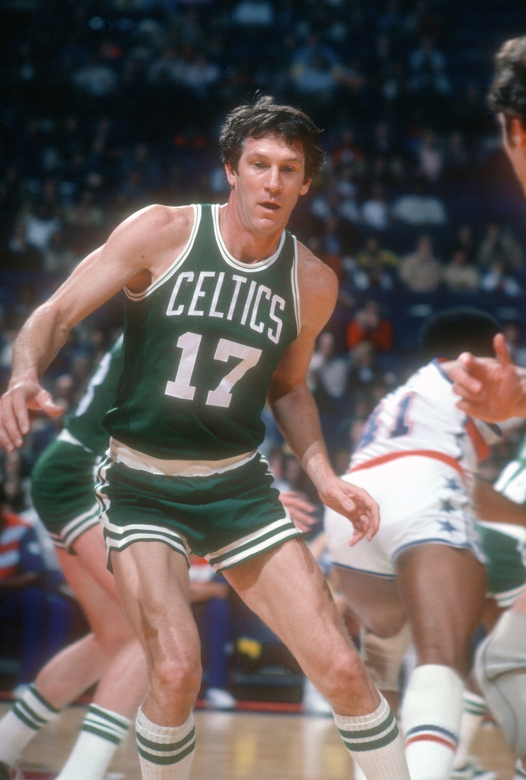
John Havlicek #18 141.66 Total Points
Points for Career Stats: 36.91 pts
Points for Winning/Accolades & Longevity/SSP: 80.75 pts
Impact & Legacy: 24/50
His stats aren’t as impressive as other players, but John Havlicek slides into the top 20 because he has 8 NBA titles; good for 3rd all-time

Slide 24
19-24
19) Karl Malone (141.55 Total Points) → 54.55 Statistics/60 Winning & Accolades/27 Legacy & Impact
20) Bob Cousy (131.93 Total Points) → 37.93 Statistics/74 Winning & Accolades/20 Legacy & Impact
21) Moses Malone (130.35 Total Points) → 47.1 Statistics/53.25 Winning & Accolades/30 Legacy & Impact
22) Oscar Robertson (129.73 Total Points) → 46.73 Statistics/ 55 Winning & Accolades/ 28 Legacy & Impact
23) Allen Iverson (129.48 Total Points) → 49.73 Statistics/ 35.75 Winning & Accolades/ 44 Legacy & Impact
24) Chris Paul (126.26 Total Points) → 42.76 Statistics/58.5 Winning & Accolades/ 25 Legacy & Impact

Slide 25
25-32
25) Nikola Jokic (125.7 Total Points) → 52.45 Statistics/43.25 Winning & Accolades/30 Legacy & Impact
26) Gary Payton (119.42 Total Points) → 38.67 Statistics/38.25 Winning & Accolades/37 Legacy & Impact
27) Dwyane Wade (119.35 Total Points) → 44.1 Statistics/53.25 Winning & Accolades/30 Legacy & Impact
28) Jason Kidd (117.5 Total Points) → 41 Statistics/ 44.5 Winning & Accolades/ 32 Legacy & Impact
29) Dirk Nowitzki (106.59 Total Points) → 44.09 Statistics/ 35.75 Winning & Accolades/ 44 Legacy & Impact
24) Isiah Thomas (105.41 Total Points) → 40.41 Statistics/30 Winning & Accolades/ 35 Legacy & Impact
31) John Stockton (104.79 Total Points) → 35.79 Statistics/ 41 Winning & Accolades/ 28 Legacy & Impact
32) Dominique Wilkins (95.08 Total Points) → 44.83 Statistics / 17.25 Winning & Accolades/ 34 Legacy & Impact

